Slide 1

MHC-PMS
Task 3: Designing a mobile app

Slide 2
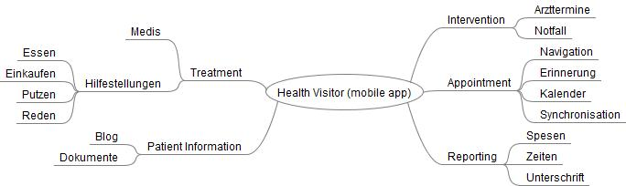
Scoping

Slide 3
Scoping
Project scope
User-friendly mobile app for health visitors
Out of scope
Server and PC UI functionality
Success measures
Accepted by the professional health visitors group
Patient Handling (To-do-List, Patient Information and Reporting) is present

Slide 4
Research
Facts from 2 health visitor interviews:
They don’t know much about the patients.
They’re not allowed to do extending treatments.
They get instructions form medical staff what they must do.
They explain that the safety of the patient data is very important.
Most of the health visitors haven’t much IT-skills.

Slide 5
Synthesize
They should be able to record the work they have done
They need information's about the patient they have
There are different existing documents (patient datasheet, care assignments, To do lists, contact information's, etc.)
The User Interface have to be simple.

Slide 6
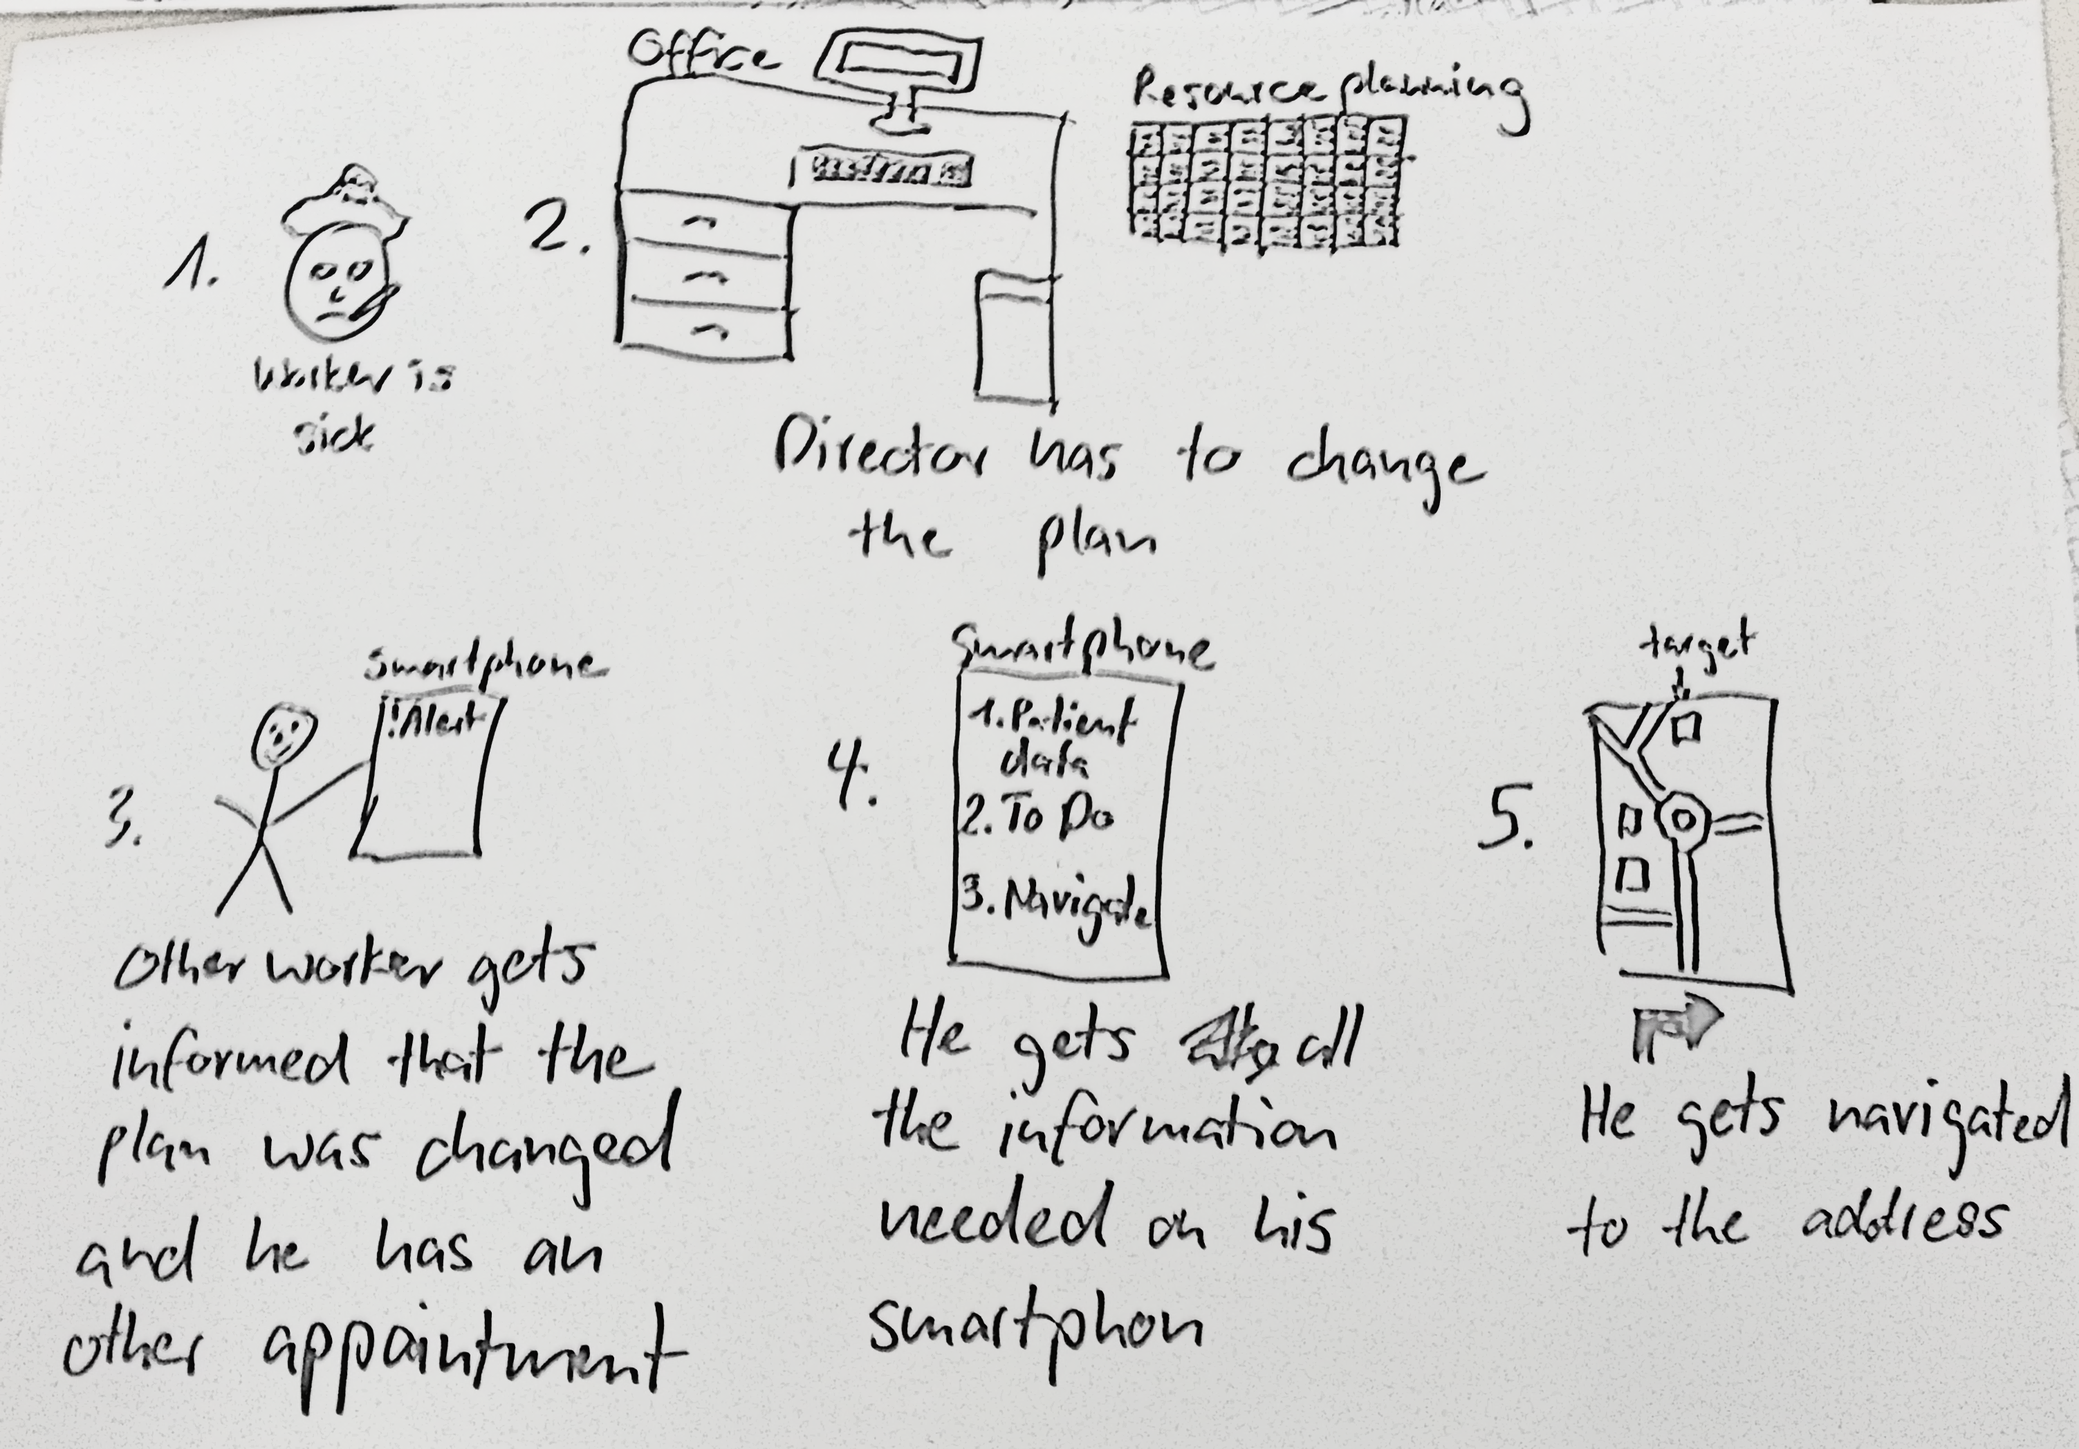
Design

Slide 7
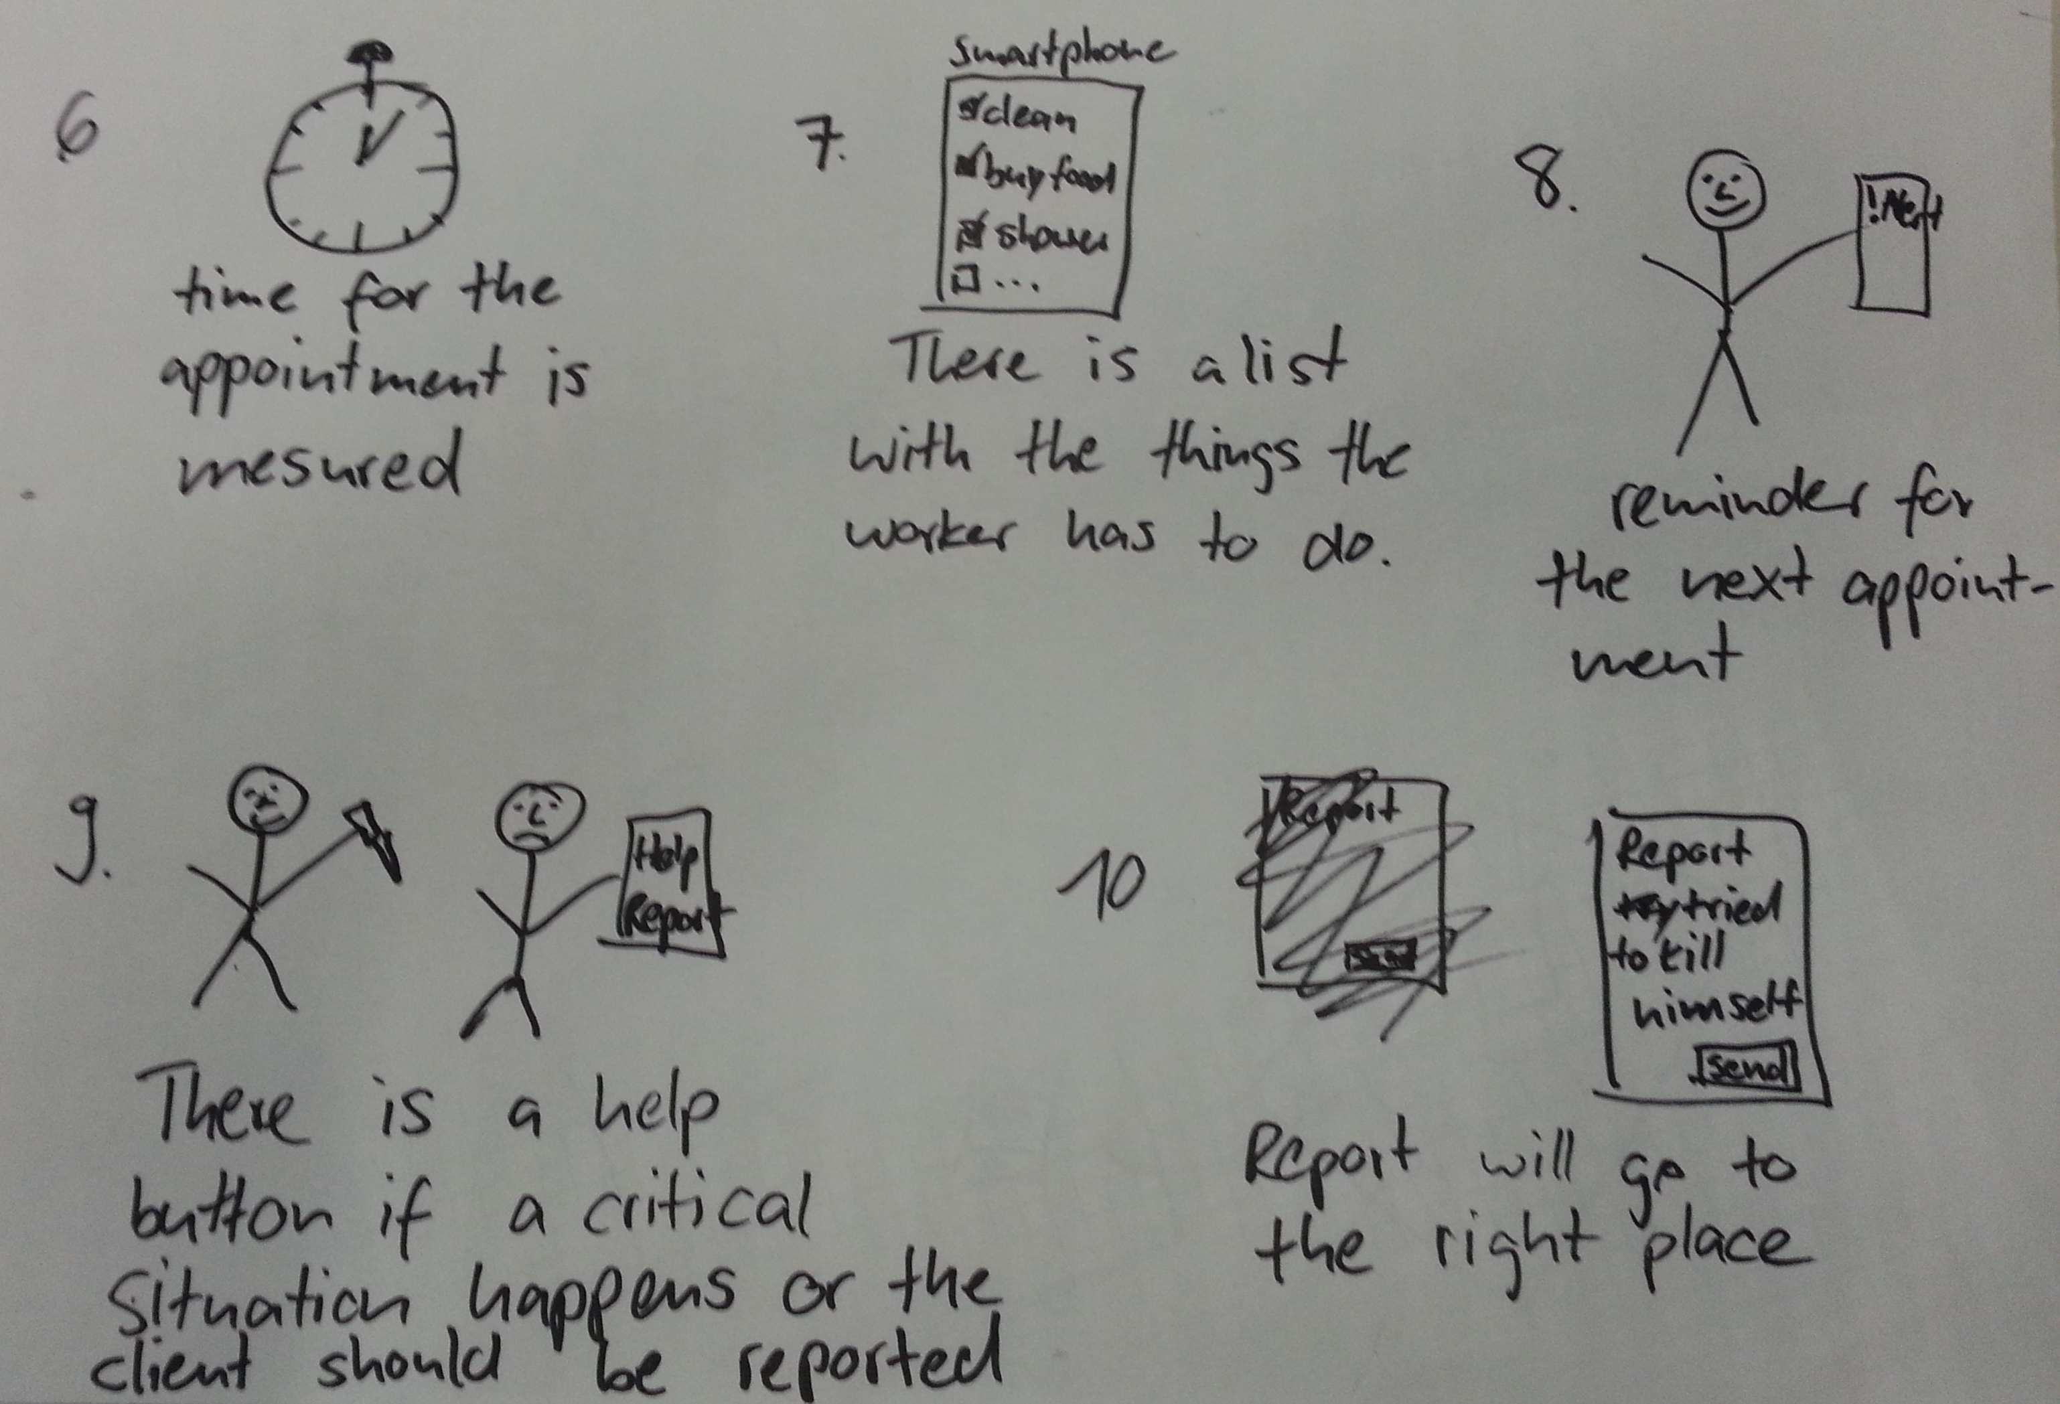
Design

Slide 8
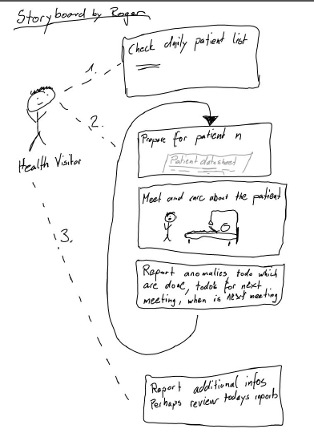
Design

Slide 9
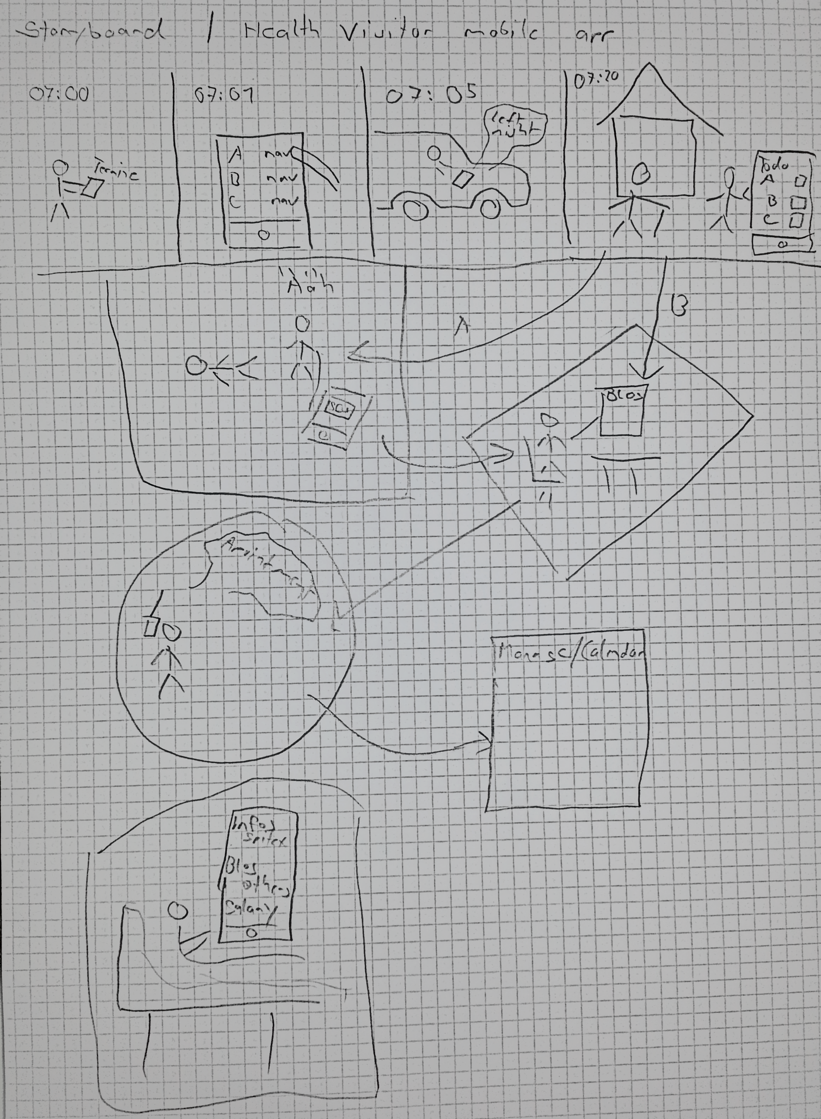
Design

Slide 10
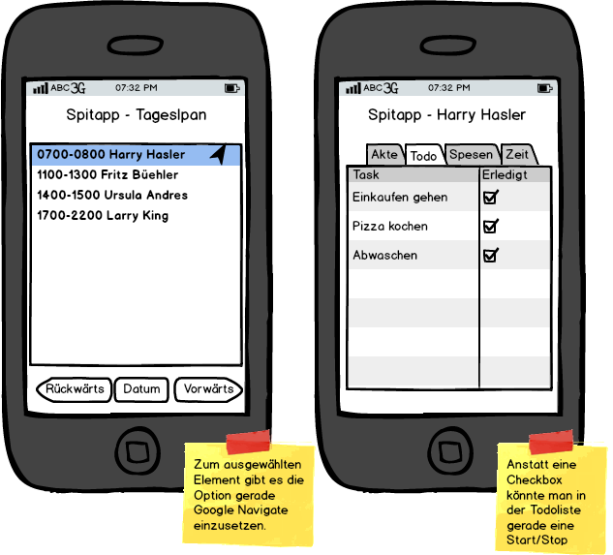
Prototype

Slide 11
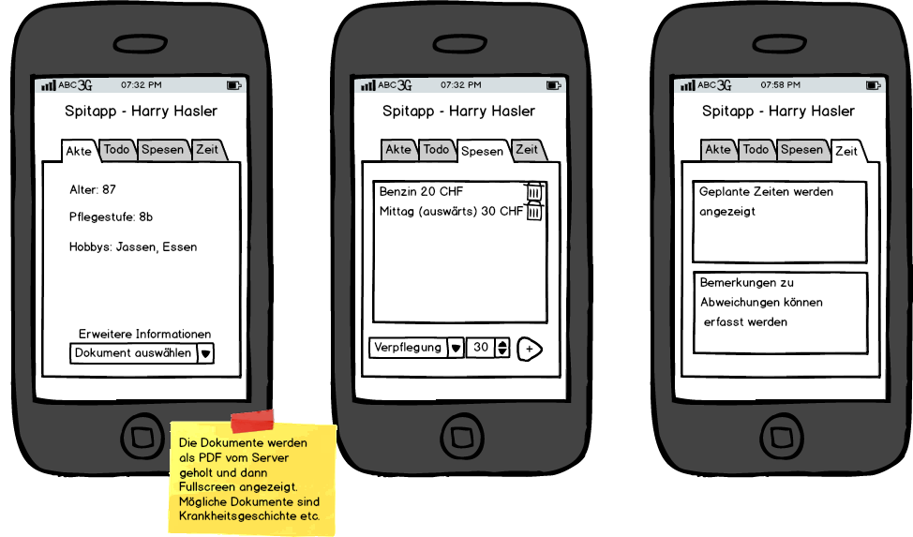
Prototype

Slide 12
Validate
Not yet completed
Show the prototype to the interview partners

Slide 13
Questions?

